Slide 1
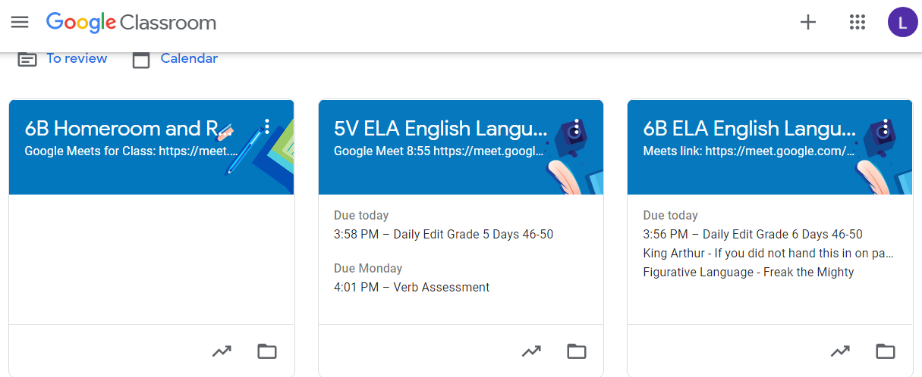
Holy Cross Middle School News Week ending 12/04/2020
Distance Learning 101:
Each academic class teacher in the 5th and 6th grade logs into the Google Classroom Meet for each academic subject (ELA, Math, Social Studies, Science).
Homeroom teachers also log into the Google Classroom for Religion and Health in the PM.
Just as if they are in the classroom…Distance Learning Students should sit at a table, and be as present and focused at home as they would be in the classroom. Students need to turn their cameras on for the whole class, and not play with backgrounds or distract others, so they can be active participants. Students who follow these directions can receive Participation Points in each academic class
The links for each Google Meet can be found in two places:
The schedule that is in your Religion/Homeroom Google Classroom.
It is also in the colored heading of each Google Classroom—even Religion and Health!
Plan Ahead: This could happen to anyone, without warning (Dumb COVID!). Think about what you would need immediately for the next few days and bring it home every day:
ELA: The novel you are reading in class, red ELA folder with current work, Daily Edit, etc.
Math: Your workbook and Daily Math
Religion: Your Religion book
Science and Social Studies: mostly online, but bring any material you are working on.
Pick ups for Distance Learners are usually Fridays, and we will create a folder for any student who is absent due to quarantine. The folders are right inside the buzzer door.
An email to your child’s homeroom teacher will be the best way to communicate a quarantine absence—and always be sure to copy in the office (TJVerzillo@dor.org, Laurie.Mcmahon@dor.org, and Laurel.turner@dor.org)
Look for a special announcement on the other side of this…
Middle School Teachers: Just a Dojo Message Away ☺
Mrs. Lauren Bates
Ms. Madison Haff
Mrs. Janet Holleran
Ms. Kathleen Vogtle
6B
6H
5H
5V
ELA, Health, Religion
Social Studies, Health, Religion Math, Health Religion
Science, Health, Religion
Lauren.Bates@dor.org and Class Dojo
Madison.Haff@dor.org and Class Dojo
Janet.Holleran@dor.org and Class Dojo
Kathleen.Vogtle@dor.org and Class Dojo

Slide 2
Opportunities To Exhibit Our Writing Skills
Young Writers Contest
Periodically a company called Young Writers solicits student-created stories. These stories are typically submitted as a group to the company, where they are reviewed. Some of the high-quality stories are chosen to be published in a book! Each class is given one copy of the book so everyone can have a chance to read the stories in print!
The criteria for the next topic of stories: A Wander in the Woods, is listed in each class’ Google Classroom under Young Writer’s Contest. If your child is interested, the stories are due to Mrs. Bates by December 16th so we can get them mailed on time. Email Lauren.Bates@dor.org if you have questions!
Jesus is Alive
Another contest we will be working on in 5th and 6th grade is Jesus is Alive. This one is not due until March, so we do have some time to work on our theme (how Jesus is alive in our lives) and ideas.
Teacher Created Materials are soliciting ideas for a nonfiction book topic they should publish next. Here is some of the information they are asking:
Do your students have a favorite author or hero but have a hard time finding books about them?
Do your students love learning about insects but you can’t find a book about the one they find most interesting?
Each student will be writing a persuasive letter as a classroom activity. One letter from each of the 4 classes will be submitted (with parent permission of course) for the contest.
Inside recess can be a bit of a drag. Kids want to get outside and play. However, the bitter cold and wet will preclude us from going out some days. That is where an idea came up for a Challenge!
Challenge 24 has been around for years. It is quite fun, and builds brain power! Perfect for inside recess.
Object of the game: Make the number 24 from the four numbers shown on a card. You can add, subtract, multiply and divide. Use all four numbers on the card, but use each number only once. You do not have to use all four operations.
This game can be just the ticket to get our students having fun with Math!
As we build our skills playing this game, we will move on to playing challenges with other classes (think March Madness brackets!). What a wonderful way to assimilate our facts, and become Mathletes!
Check it out on-line—might be a great stocking stuffer for Santa!
Timely Reminders for Students and Parents
Holy Cross School has started collecting cereal for The House of Mercy. Our goal is to collect 250 boxes by December 14th We better get going to meet this goal! Everyone should bring in a box of cereal next week, please, for the food cupboard.
There will be in-home learning on Monday, December 14. See Mr. Verzillo’s email for the
explanation. Each student must log into their Google Classroom Meet for each of the 4 academic
periods on Monday, as well as Religion or Health if it is a schedule class. We’ll be back Tuesday, 12/15.
The kids are doing very well wearing their masks, washing hands, and keeping distance. It is not easy, and we do have to give reminders, but for the most part, we are so very proud of them and YOU!!

