Slide 1
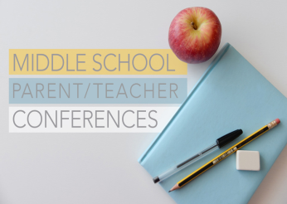
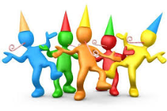
Holy Cross Middle School News Week ending 10/25/2020
Your child’s Middle School Teachers and how to contact them:
Mrs. Lauren Bates
Ms. Madison Haff
Mrs. Janet Holleran
Ms. Kathleen Vogtle
6B
6H
5H
5V
English Language Arts, Health, Religion
Social Studies, Health, Religion
Math, Health, Religion
Science, Health, Religion
Lauren.Bates@dor.org and Class Dojo
Madison.Haff@dor.org and Class Dojo
Janet.Holleran@dor.org and Class Dojo
Kathleen.Vogtle@dor.org and Class Dojo
Parent Teacher Conferences
Students will be out of school on Tuesday, November 3, so that the teachers can conduct parent-teacher conferences. These meetings are not mandatory for everyone this year, but may be requested by the teacher or the parent.
In 5th and 6th grade, all four of the teachers will be meeting with parents at the same time. We will contact the parents of students with whom we would like to talk.
You can contact your child’s homeroom teacher if you have a specific need to meet with the team.
Homeroom teachers will be grading each
student’s Book BINGO activities and giving
Mrs. Bates the grade for ELA.
There will be a celebration and special prizes, in each class next
week, for those who completed the Book BINGO expectations.
Reading for Book BINGO Board 2 can begin whenever the student has completed and handed in Book BINGO 1.
Book BINGO is in place of Accelerated Reading for Grade 5 and 6 to prepare them for Junior High. We are expecting that our students in 5th and 6th grade will enjoy being exposed to different genres, reading at a higher level, and creating celebration activities that can display what they have learned!
Book BINGO (was) due
October 30th
Quarantining? Don’t Miss a Beat!
Each academic class teacher in the 5th and 6th grade logs into the Google Classroom Meet.
This link can be found in two places: 1. The schedule that is in your Religion/Homeroom Google Classroom. 2. It is also in the colored heading of each Google Classroom—even Religion and Health!
Plan Ahead: This might happen to you, think about what you would need immediately for the next few days. Pick ups for Distance Learners are Fridays, and we will create a folder for you!
ELA: The novel you are reading in class, your library books, Daily Edit, etc.
Math: Your workbook and Daily Math
Religion: Your Religion book
Science and Social Studies, are mostly online, but bring material you are working on.
Technology, PE, Art, and Music teachers give Distance Learning students information for assignments you can do to keep up your grades.

Slide 2
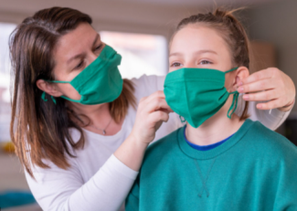
Other Important Information for 5th and 6th Grade Families
What is Happening in Social Studies?
Students are currently learning about the 2020 Presidential Election in Social Studies class.
We are researching and reading information in class that pertains to how an election works. Students are learning about the different political parties, campaigns, sources, and other parts that go into the United States’ election process.
The students are completing many activities during class. There is a debate/essay coming up next week. I have given students a choice to either participate in a debate or write an essay. The students will be given class time to complete this and organize their thoughts.
The expectations are very clear, as to what assignments are required for this unit. It is such a relevant time for age-appropriate comprehension of the election process. Please let me know if there are any questions.
Ms. Haff
Fantastic reminders for students and parents
Write your homework assignments in your planner when instructed.
Do not procrastinate on assignments! It will be difficult to catch up, and very stressful if you fall behind.
Meet with your teacher if you are having trouble, and get help to map out a plan if you are struggling. We WANT you to be successful!
Know that all grades can be seen in MSP, along with missing, late, or incomplete comments.
Let your teacher and the office know if you are going to be absent or have a change in your dismissal. Communication is key!
Make sure you have a mask that fits over both your nose and mouth.
As tired as you are of being reminded, so are we of reminding you ☺
All late and missing assignments for Quarter 1 are due to the academic teacher by Monday, November 2

