Slide 1
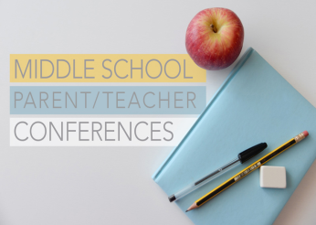
Holy Cross Middle School News Week ending 10/25/2020
Your child’s Middle School Teachers and how to contact them:
Mrs. Lauren Bates
Ms. Madison Haff
Mrs. Janet Holleran
Ms. Kathleen Vogtle
6B
6H
5H
5V
English Language Arts, Health, Religion
Social Studies, Health, Religion
Math, Health, Religion
Science, Health, Religion
Lauren.Bates@dor.org and Class Dojo
Madison.Haff@dor.org and Class Dojo
Janet.Holleran@dor.org and Class Dojo
Kathleen.Vogtle@dor.org and Class Dojo
Parent Teacher Conferences
Students will be out of school on Tuesday, November 3, so that the teachers can conduct parent-teacher conferences. These meetings are not mandatory for everyone this year, but may be requested by the teacher or the parent.
In 5th and 6th grade, all four of the teachers will be meeting with parents at the same time. We will contact the parents of students with whom we would like to talk.
You can contact your child’s homeroom teacher if you have a specific need to meet with the team.
Book BINGO due
October 30th
Step 1. Read a book in your Lexile Level
Step 2. Complete a Celebration Activity
Step 3. Repeat 4 More times by October 30
Junior High School Visits: For 6th Graders
All of our Virtual Visits have taken place. These provided an idea of what each school has to offer for next year’s 7th graders’ educational experience.
The schools sent information home with the students, along with the dates of their virtual Open Houses and shadow days. This can also be found on their websites.
One of the presenters said it best, “What you, as 6th graders are doing right now with your academics and behaviors, are very important indicators, and a big part of these decisions.”
Schools require written teacher recommendations and observations. It is not a time for students to “take their foot off the academic gas pedal”.
Halloween!
Yes, we will be having some fun on Thursday to celebrate Halloween.
Please watch for an email or Dojo message from your homeroom teacher with the details!

Slide 2
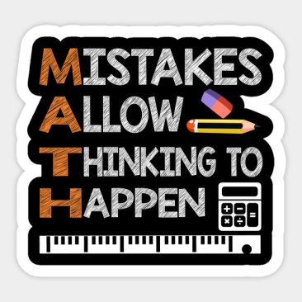
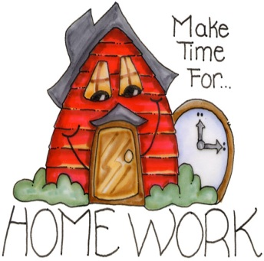
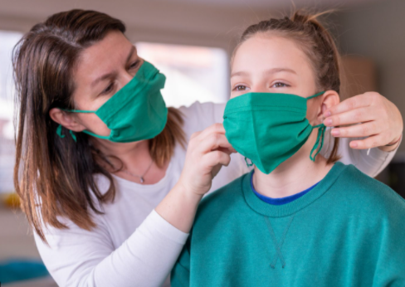
Other Important Information for 5th and 6th Grade Families
What is Happening in Math?
5th graders are jumping into the concept of long division in chapter 2! Don't worry parents, Mrs. Holleran is teaching them the "traditional algorithm," a.k.a. the way WE learned it!!! So homework time won't be as frustrating for kids and parents, alike!
In 6th grade right now, math concepts are all based in fractions and decimals and we've learned that fractions and decimals are one in the same. Already we are learning to "speak fraction," which means that instead of saying zero point six eight five (0.685), we are saying six-hundred eighty-five thousandths!
Keeping up with the Notes in class, and completing all homework on time is a recipe for success in Math!
Great News from,
Mrs. Holleran
Fantastic reminders for students and parents
Write your homework assignments in your planner when instructed.
Do not procrastinate on assignments! It will be difficult to catch up, and very stressful if you fall behind.
Meet with your teacher if you are having trouble, and get help to map out a plan if you are struggling. We WANT you to be successful!
Know that all grades can be seen in MSP, along with missing, late, or incomplete comments.
Students who are absent (and able) can log into the Google Meet if they are able– as to not miss a class. Ah, the marvels of technology. Go right to your Google Classroom or the Class Schedule for the link.
Let your teacher and the office know if you are going to be absent or have a change in your dismissal. Communication is key!
Make sure you have a mask that fits over both your nose and mouth.
As tired as you are of being reminded, so are we of reminding you ☺

