Slide 1
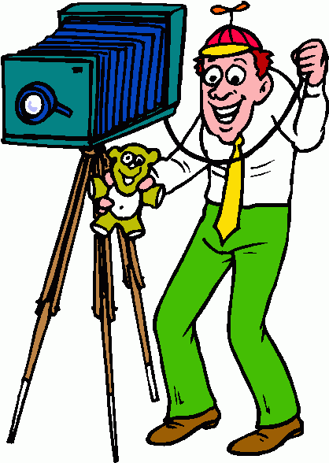
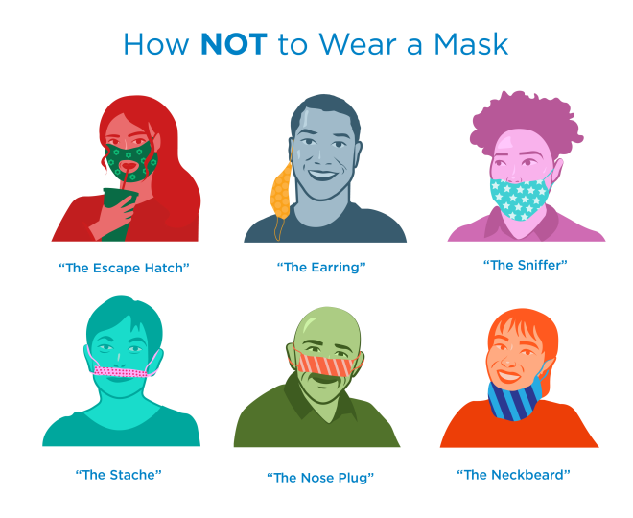
Holy Cross Middle School News Week ending 10/16/2020
Your child’s Middle School Teachers and how to contact them:
Mrs. Lauren Bates
Ms. Madison Haff
Mrs. Janet Holleran
Ms. Kathleen Vogtle
6B
6H
5H
5V
English Language Arts, Health, Religion
Social Studies, Health, Religion
Math, Health, Religion
Science, Health, Religion
Lauren.Bates@dor.org and Class Dojo
Madison.Haff@dor.org and Class Dojo
Janet.Holleran@dor.org and Class Dojo
Kathleen.Vogtle@dor.org and Class Dojo
Picture Day!
Grades 5 and 6 will be on Wednesday, October 21.
Distance Learners should come during school hours, over in the Parish Center. You do not need to come at the same time your class goes—just a time that you can come.
Pictures are an important part of a student’s permanent record.
Junior High School Visits: For 6th Graders
Thursday, October 15 the 6th Graders had a virtual visit from the Mercy and McQuaid Admission people.
This coming Monday, October 19 the 6th graders will have a presentation from Aquinas.
Then on Thursday, October 22 they will hear from Bishop Kearney.
All of the schools are having virtual Open Houses, and
virtual shadow experience.
Look at the websites for more information.
If you need help, please ask Mrs. Bates
Procedures & Protocols
Wearing a mask all day is not easy, but it is a sacrifice everyone in this building knows is important. We do have to remind some students to keep their noses covered—ask your child if he or she is wearing it well!
Know that every day, each academic class logs into the Google Classroom for the Distance Learners. If your child is sick, or in a quarantine situation, please have him or her log into the class at the scheduled time. That way they will not miss that class, and keep up with their class.

Slide 2
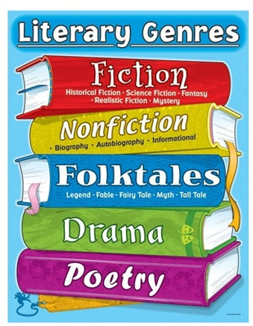
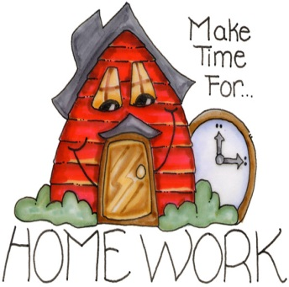
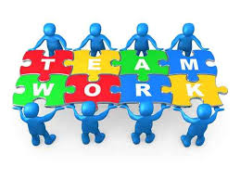
Other Important Information for 5th and 6th Grade Families
What is the one thing you must do BEFORE you read a book for Book BINGO?
Check the LEXILE! Each book you read for BB, must be in your Lexile Range.
You can use: https://hub.lexile.com/find-a-book/search
READ 5 BOOKS, CREATE 5 CELEBRATION ACTIVITIES!
What are Celebration Activities?
Celebrations Activities are activities a student does after he or she reads a book:
Take a Quiz on Whooooo’s Reading
Each response must be at least 5 sentences long to receive credit.
You must ‘Perfect Your Writing Skills’ by following the Owl’s directions and receive a 4 out of 4.
Type a Book Summary
Demonstrate your writing skills, include all story elements.
Elements: plot, conflict, setting, characters, conflict resolution, etc.
Type a Book Review
You can type your book review on Google Docs and attach it to your Recording Card
Give a quality Book Talk
To the class using PowerPoint, a poster or other creative visual.
Must be practiced at home beforehand.
Type a 10 Question Quiz
Questions must be well thought out with options for answers that cause the reader to stop and think! Include an answer key.
Draw and color a Full-Page Picture
This must include your favorite part and include a Caption Paragraph.
You can only do this activity once per board.
You may C-Y-O Celebration Activity (with teacher approval).
CYO = Create your own activity.
**This must be approved AHEAD OF TIME, BEFORE YOU DO IT.**
Book BINGO due
October 30th
Homework, Classwork and Assessments
These are all important elements of your child’s learning, and the basis for the calculation of his or her grades.
In the 5th and 6th grade, we use the Homework Agenda or Planner to write in homework assignments, assessments, etc. to foster independence and organization. Feel free to look at the agenda and ask your child about the completion of assignments, as they practice these life-long skills.
Consistency in the time and special place for homework can assist the student in completing assignments, and focus on studying and reading .
The teachers enter grades into MSP, which can be accessed by families.
Teachers might contact parents if we need your support in helping your child be more successful in his or her academic endeavors.
Please let the appropriate teacher know if you see something amiss, or something you have a question on.
We are very grateful when we can work together as partners with you and your child.

